Slide 1



DS salaries report
View in Power BI
Last data refresh:
3/29/2024 2:44:40 PM UTC
Downloaded at:
3/29/2024 8:20:13 PM UTC

Slide 2
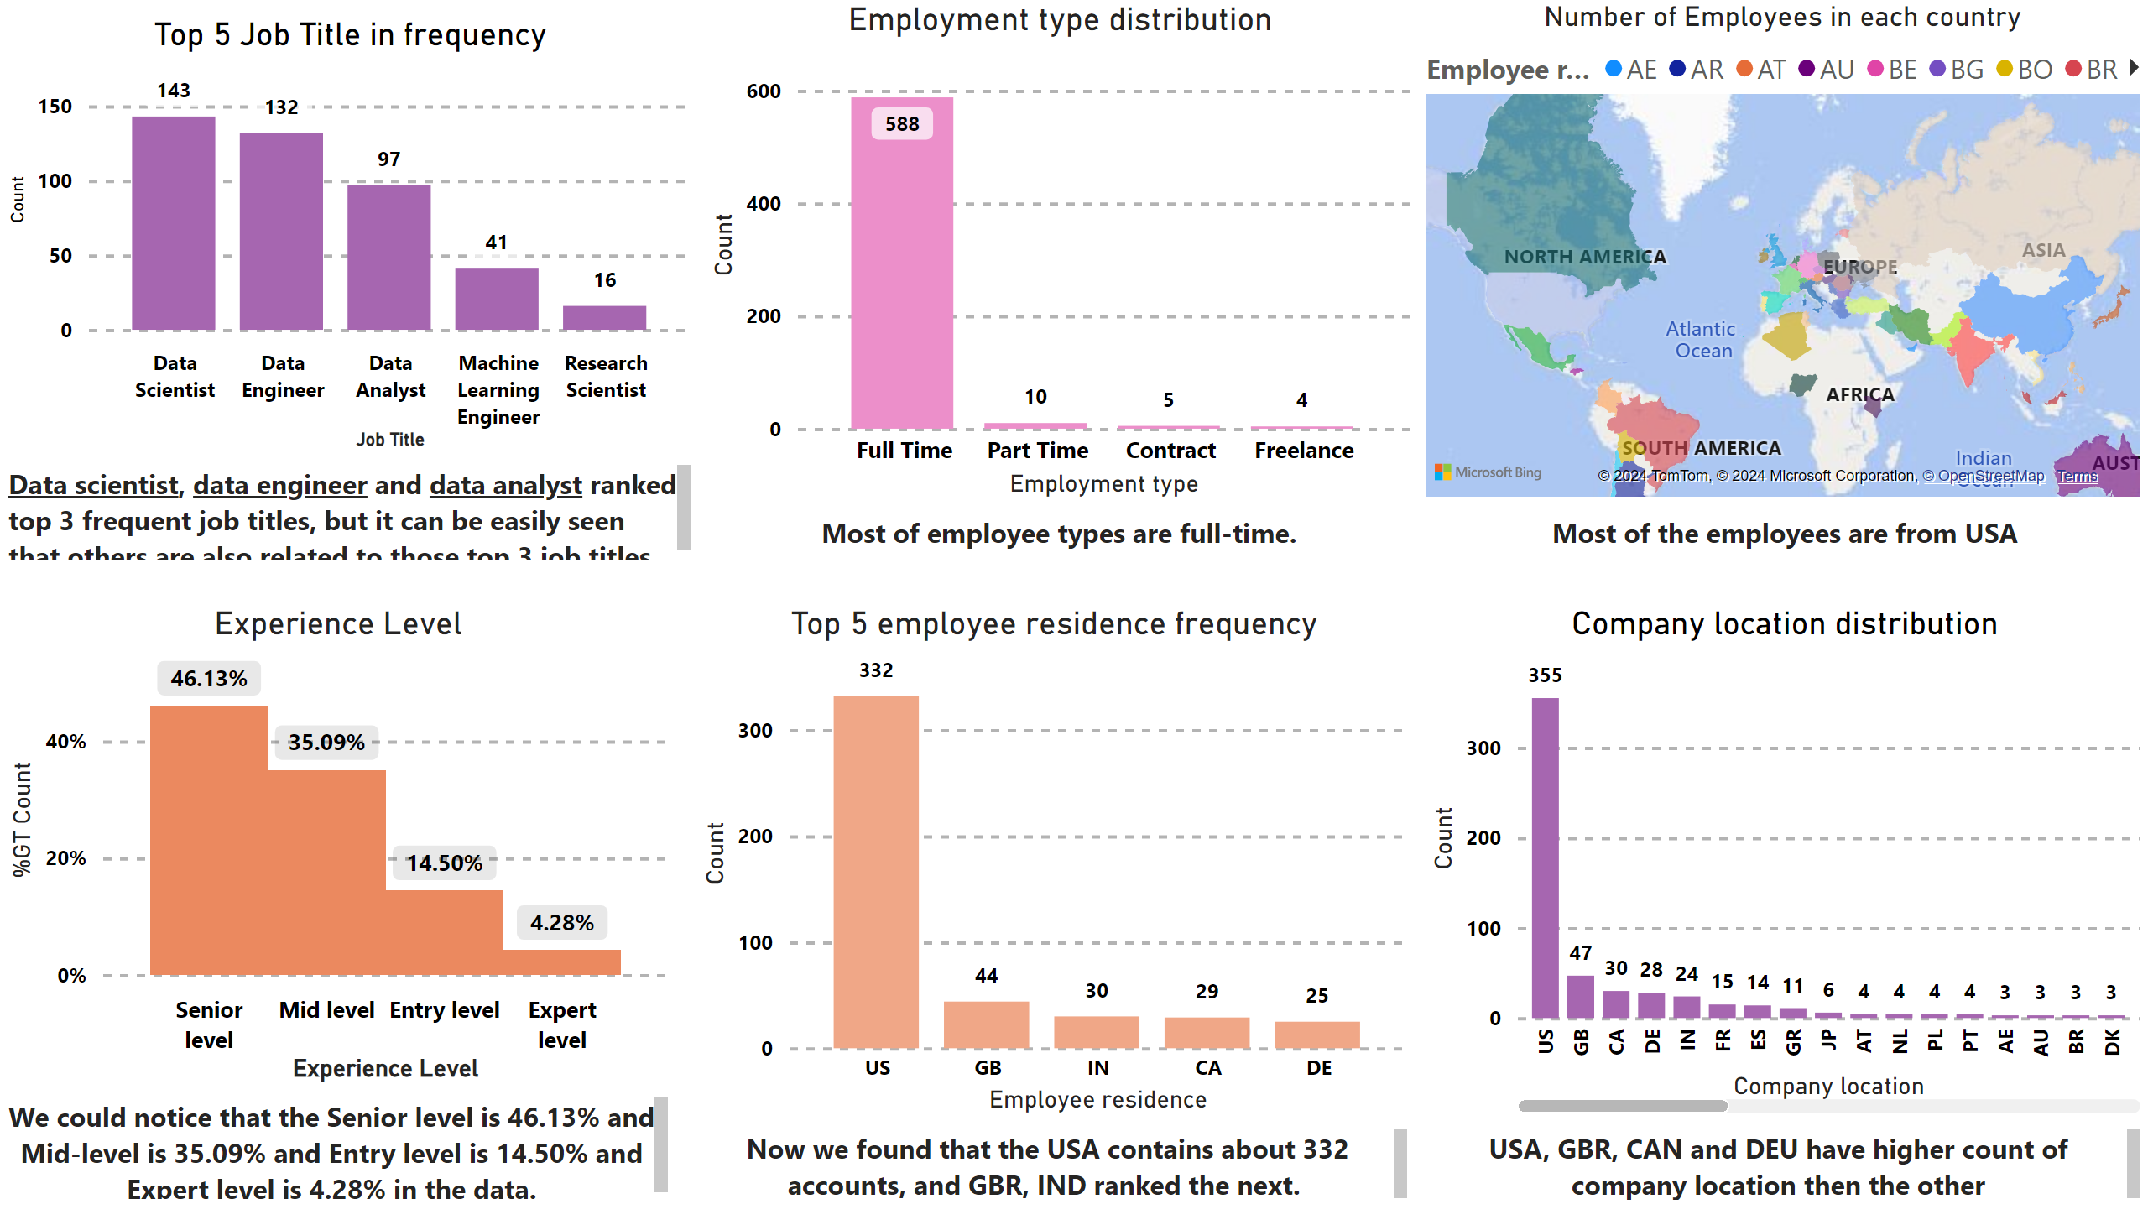
Page 1
Notes:
Experience Level
No alt text provided
Top 5 Job Title in frequency
No alt text provided
Employment type distribution
No alt text provided
Number of Employees in each country
No alt text provided
Top 5 employee residence frequency
No alt text provided
Company location distribution
No alt text provided
textbox
No alt text provided
textbox
No alt text provided
textbox
No alt text provided
textbox
No alt text provided
textbox
No alt text provided
textbox
No alt text provided

Slide 3
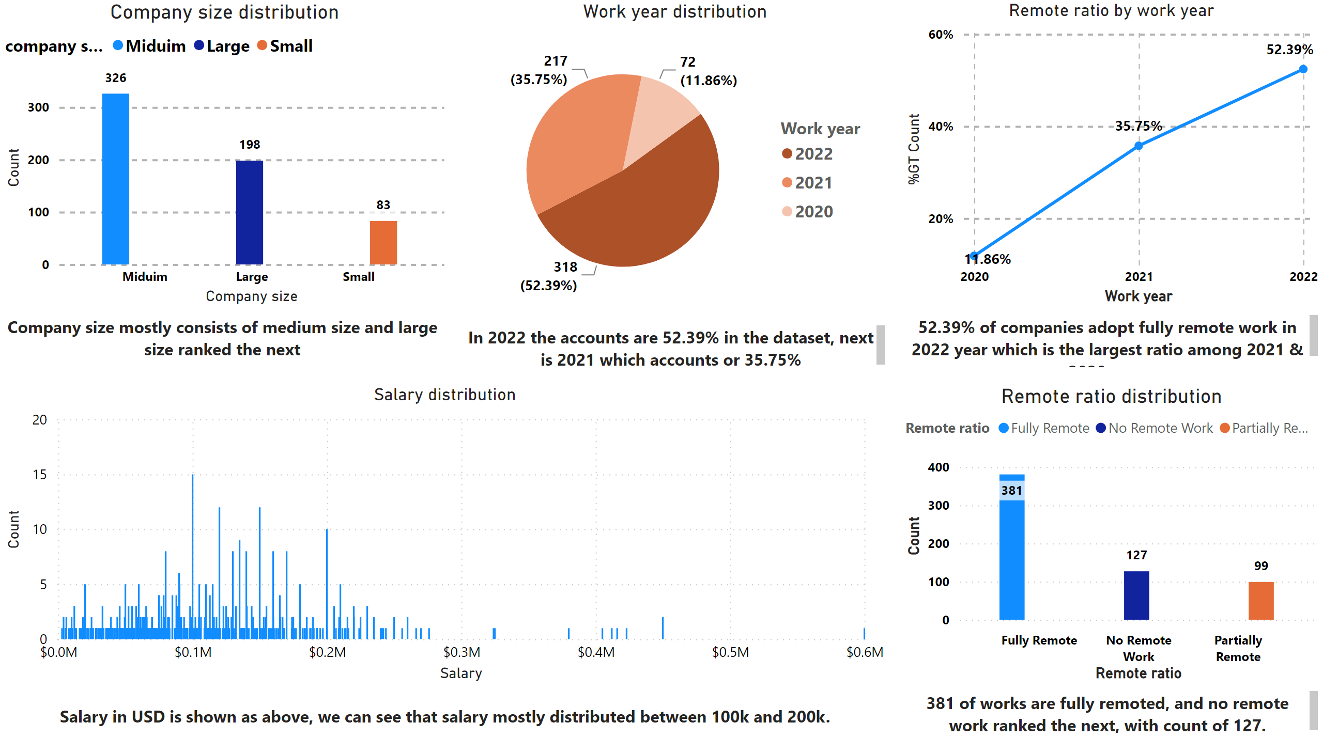
Page 2
Notes:
Company size distribution
No alt text provided
Work year distribution
No alt text provided
Remote ratio distribution
No alt text provided
Remote ratio by work year
No alt text provided
textbox
No alt text provided
textbox
No alt text provided
textbox
No alt text provided
textbox
No alt text provided
textbox
No alt text provided
Salary distribution
No alt text provided

Slide 4
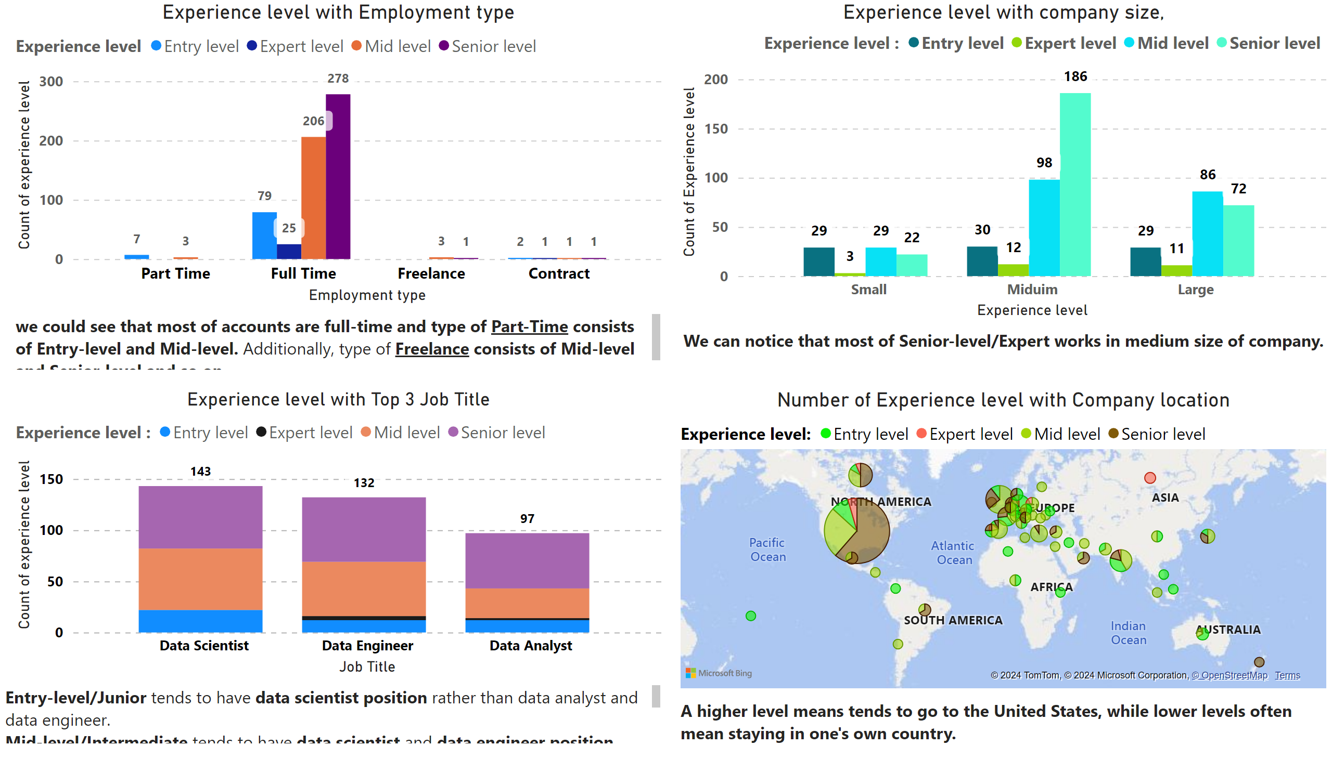
Page 3
Notes:
Experience level with Employment type
No alt text provided
Experience level with Top 3 Job Title
No alt text provided
Experience level with company size,
No alt text provided
Number of Experience level with Company location
No alt text provided
textbox
No alt text provided
textbox
No alt text provided
textbox
No alt text provided
textbox
No alt text provided

Slide 5
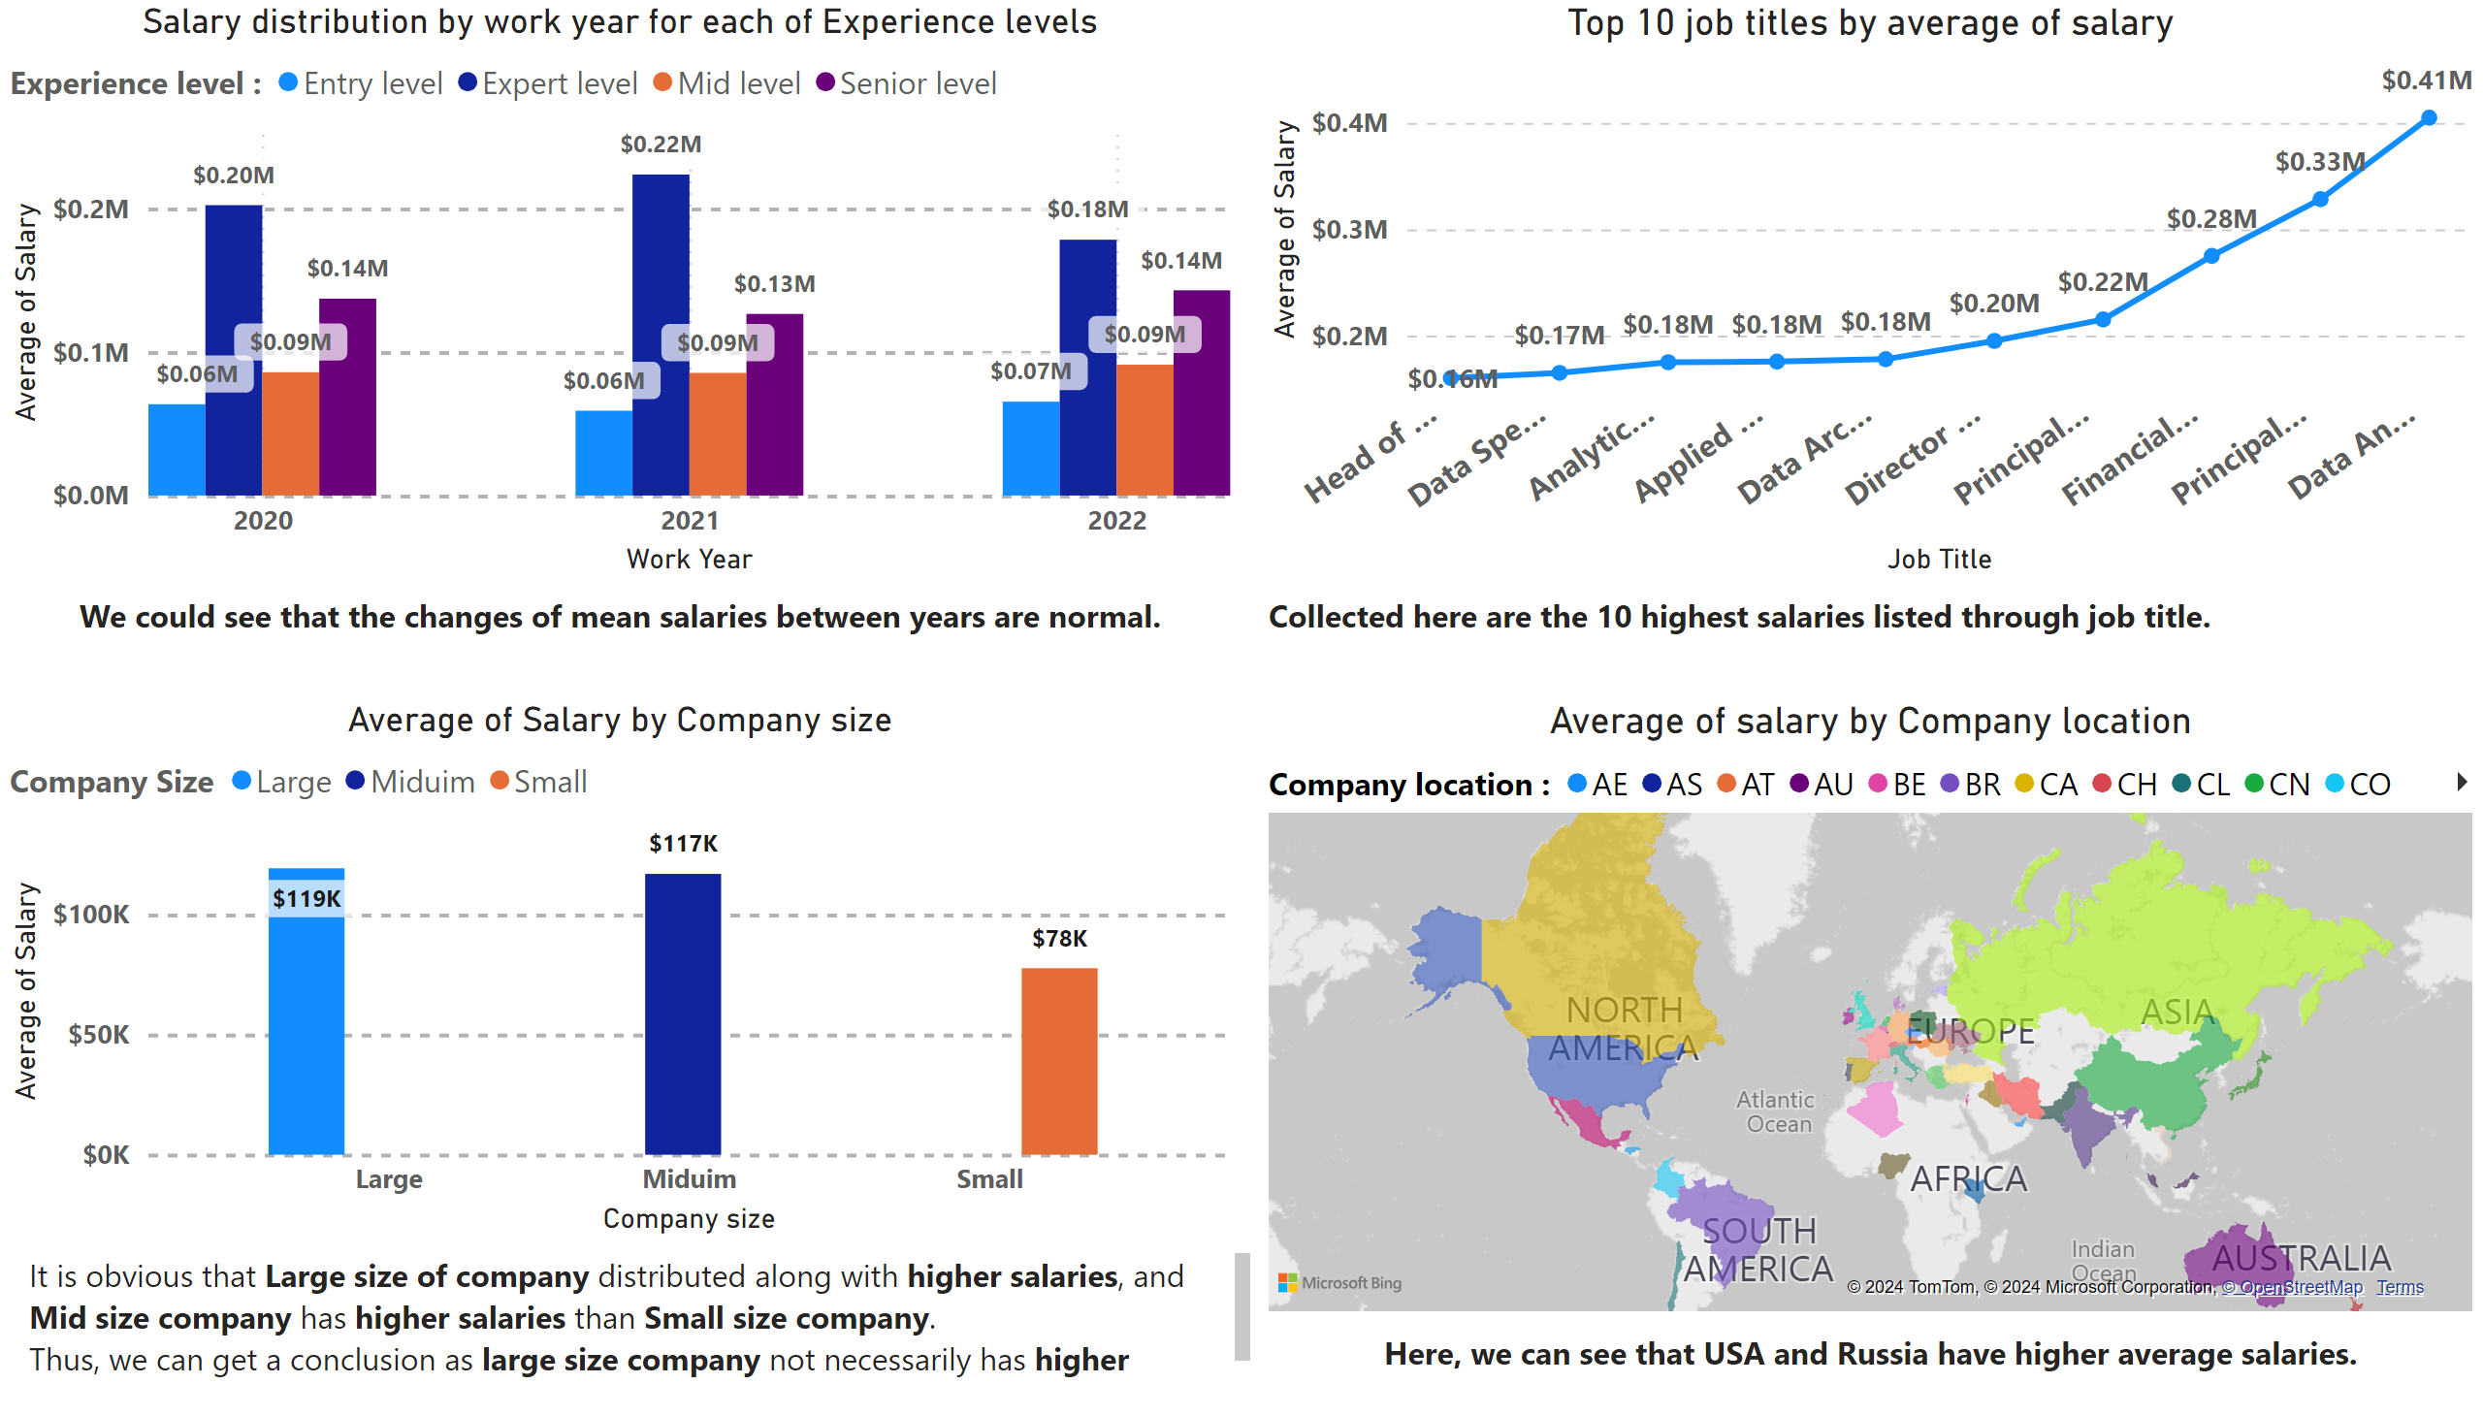
Page 4
Notes:
Salary distribution by work year for each of Experience levels
No alt text provided
Average of Salary by Company size
No alt text provided
Top 10 job titles by average of salary
No alt text provided
Average of salary by Company location
No alt text provided
textbox
No alt text provided
textbox
No alt text provided
textbox
No alt text provided
textbox
No alt text provided

